Slide 1
Machine learning
Overview, goals, learning types and algorithms
Data selection, preparation, and modeling
Feature selection and feature engineering
Model evaluation, validation, complexity and improvement
Model tweaking, regularization, and hyperparameter tuning:

Slide 2
Machine learning
Very popular computer science discipline,
part of data science
Machine learning is about designing algorithms (like data mining), but emphasis is on prototyping algorithms for production mode, and designing automated systems (bidding algorithms, ad targeting algorithms) that automatically update themselves, constantly train/retrain/update training sets/cross-validate and refine or discover new rules (fraud detection) on a daily basis.

Slide 3
definition
The often quoted and widely accepted formal definition of machine learning as stated by field pioneer Tom M. Mitchell is:
A computer program is said to learn from experience E with respect to some class of tasks T and performance measure P if its performance at tasks in T, as measured by P, improves with experience E
Machine learning is a subfield of computer science,
also referred to as predictive analytics or predictive modeling.
Its goal and usage is to build new and/or leverage existing algorithms to learn from data, in order to build generalizable models that give accurate predictions, or to find patterns, particularly with new and unseen similar data.
ML is a discipline that evolved from artificial intelligence (AI), but it focuses more on cognitive learning capabilities

Slide 4
Customer Relationship Management
1. Sales Predictions
sales by individual customer, customer type, region, salesperson or office, or by product.
The same basic data from the CRM database are used to make all these predictions, with analysts using roughly the same algorithms in the machine learning platform.
predictions assist planning, budgeting, and staffing decisions.
In most companies, machine learning – based predictions provide a second opinion on future sales volumes to compare to the traditional forecasting methods inside CRM applications.

Slide 5
Customer Relationship Management
2. Reorder Events
CRM data also hold the key to predicting when repeat customers will buy again.
In the statistics of the prediction is an inherent error that corresponds roughly to what salespeople think of as a window.
The center of the prediction is the most likely date for a next order, with a window of time on either side.
Communicating this window for individual customers to the salesperson responsible provides a systematic prompt for action.

Slide 6
Customer Relationship Management
3. Response Rates to Contact Methods
CRM data also hold the key to predicting when repeat customers will buy again.
In the statistics of the prediction is an inherent error that corresponds roughly to what salespeople think of as a window.
The center of the prediction is the most likely date for a next order, with a window of time on either side.
Communicating this window for individual customers to the salesperson responsible provides a systematic prompt for action.

Slide 7
Customer Relationship Management
4. Text (Context) Mining
A lot of useful information collects in text fields within the CRM data.
Several types of text mining methods in machine learning look at text and determine contextual characteristics such as tone as well as specifics topics like product, salesperson, complaint, or praise.
With a context evaluation coming from the machine learning model, larger machine learning and predictive systems can use what would otherwise be locked-away blobs of text.

Slide 8
Customer Relationship Management
5. Prospect Scoring
Machine learning groups prospects into categories similar to groupings of existing customers who have the same traits.
Based on a customer’s history, the algorithm assesses individual prospects so that companies and salespeople can prioritize their efforts.

Slide 9
Customer Relationship Management
6. Customer Service Predictions
Machine learning can make predictions about how many support events or how much support effort will be required based on the history of post-sales contacts in the CRM database.
As the products companies sell change over time, customer service gets a longer planning horizon.

Slide 10
Finance and Hedge Fund Portfolio Pricing

Slide 11
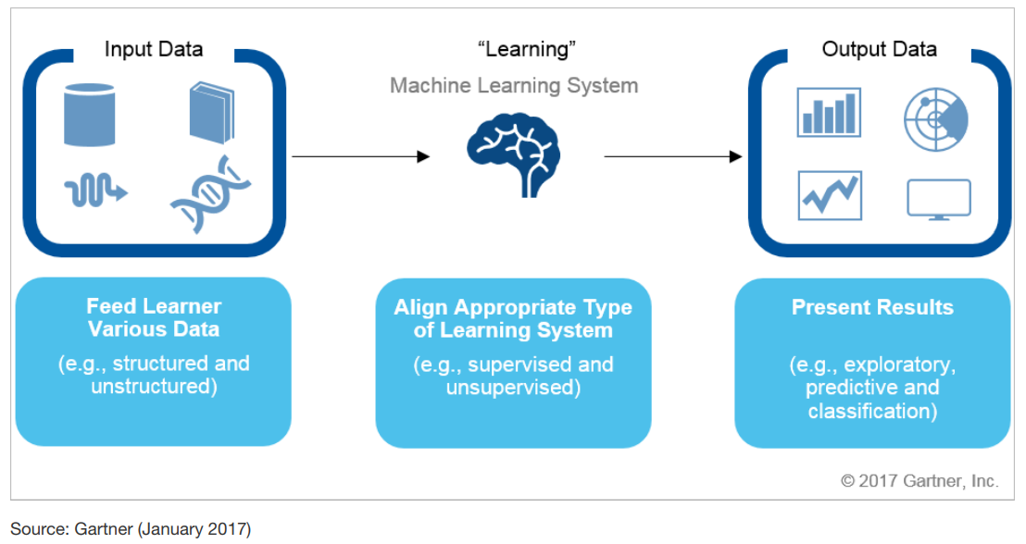
Machine Learning Process Overview
Input data: A wide variety of data can be used as input for ML purposes, variety of sources, enterprise, mainframes, IOT devices. Formats – structured or unstructured.
Learning: Typically, the ML used for business purposes is either supervised or unsupervised in
nature.
Eager learning methods evaluate training data and "eagerly" begin computing before receiving new (test) data.
Lazy learning methods delay processing and data evaluation until new test data is provided
Output data: ML can be used to deliver results that are either predictive (that is, providing forecasts) or prescriptive (that is, suggesting recommended actions).

Slide 12
Variable types
Dependent and Independent Variables
An independent variable, sometimes called an experimental or predictor variable, is a variable that is being manipulated in an experiment in order to observe the effect on a dependent variable, sometimes called an outcome/response/target variable.
Dependent Variable: Test Mark (measured from 0 to 100)
Independent Variables: Revision time (measured in hours), Intelligence (measured using IQ score)

Slide 13
Variable types - Categorical
Categorical variables are also known as discrete or qualitative variables.
Categorical variables can be further categorized as either
nominal,
ordinal or
dichotomous.

Slide 14
Variable types - Categorical
Nominal variables are variables that have two or more categories, but which do not have an intrinsic order.
For example, a real estate agent could classify their types of property into distinct categories such as houses, condos, co-ops or bungalows.
So "type of property" is a nominal variable with 4 categories called houses, condos, co-ops and bungalows.

Slide 15
Variable types - Categorical
Dichotomous variables are nominal variables which have only 2 categories or levels.
For example, if we were looking at gender, we would most probably categorize somebody as either "male" or "female". This is an example of a dichotomous variable (and also a nominal variable).
Another example might be if we asked a person if they owned a mobile phone. Here, we may categorize mobile phone ownership as either "Yes" or "No".
In the real estate agent example, if type of property had been classified as either residential or commercial then "type of property" would be a dichotomous variable.

Slide 16
Variable types - Categorical
Ordinal variables are variables that have two or more categories just like nominal variables
the categories can also be ordered or ranked.
Survey: Do you like the policies of NDA government, the responses may be
"Not very much",
"They are OK" or
"Yes, a lot" .
you can rank them from the
most positive ( Yes, a lot)
middle response (They are OK)
least positive (Not very much).
However, whilst we can rank the levels, we cannot place a "value" to them; we cannot say that "They are OK" is twice as positive as "Not very much"

Slide 17
Variable types - Continuous
Interval variables are variables for which their central characteristic is that they can be measured along a continuum and they have a numerical value
(for example, temperature measured in degrees Celsius or Fahrenheit). So the difference between 20C and 30C is the same as 30C to 40C. However, temperature measured in degrees Celsius or Fahrenheit is NOT a ratio variable.
Ratio variables are interval variables, but with the added condition that 0 (zero) of the measurement indicates that there is none of that variable.
So, temperature measured in degrees Celsius or Fahrenheit is not a ratio variable because 0C does not mean there is no temperature. However, temperature measured in Kelvin is a ratio variable as 0 Kelvin (often called absolute zero) indicates that there is no temperature whatsoever.
Other examples of ratio variables include height, mass, distance and many more.
The name "ratio" reflects the fact that you can use the ratio of measurements. So, for example, a distance of 10 meters is twice the distance of 5 meters.

Slide 18
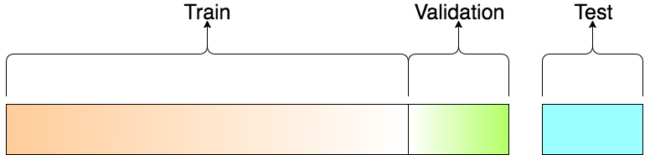
datasets
Training set
Validation set
Test set

Slide 19
datasets
Training set | Validation set | Test set
a set of examples used for learning: to fit the parameters of the classifier | set of examples used to tune the parameters of a classifier/ regressor | a set of examples used only to assess the performance of a fully-trained classifier
 | Oftentimes, these sets are taken from the same overall dataset | used once a model is completely trained(using the train and validation sets) …should be used at the very end
 | implicitly leaking information to the model (bias) | give an unbiased estimate of model accuracy.

Slide 20
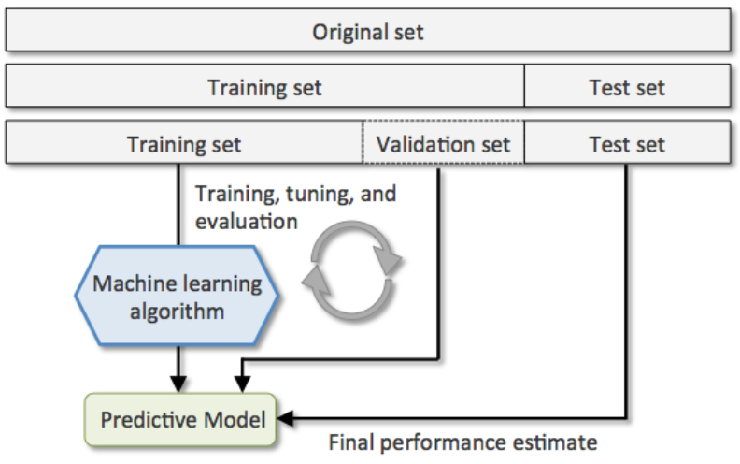
datasets
Why separate test and validation sets?
The error rate estimate of the final model on validation data will be biased (smaller than the true error rate) since the validation set is used to tune the model
After assessing the final model on the test set, YOU MUST NOT tune the model any further!

Slide 21
Why Training Data matters?
Algorithms learn from data.
They find relationships, develop understanding, make decisions, and evaluate their confidence from the training data they’re given. And the better the training data is, the better the model performs.
In fact, the quality and quantity of your training data has as much to do with the success of your data project as the algorithms themselves.
Basically, training data is enriched or labeled data we need to train our machine learning models.

Slide 22
How much training data is enough?
There’s really no hard-and-fast rule around how much data we need as training set.
Different use cases, after all, will require different amounts of data.
Ones where you need our model to be incredibly confident (like self-driving cars) will require vast amounts of data, whereas a fairly narrow sentiment model that’s based off text necessitates far less data.
As a general rule of thumb though, you’ll need more data than you’re assuming you will. -:)

Slide 23
Training data and big data
Big data and training data are not the same thing. Gartner calls big data “high-volume, high-velocity, and/or high-variety” and this information generally needs to be processed in some way for it to be truly useful.
Training data, as we mentioned above, is labeled data used to teach AI models or machine learning algorithms.

Slide 24
What are good and bad training and test data sets?
the training and test data set must be a representative sample of the target data.; e.g. if it is time-series data about sales, the training and test dataset ought to represent a reasonable business cycle that covers peak and off-peak times, weekends, etc.
NLP/Text Analytics - sentiment analysis, it’s important to cover as many words as possible that express sentiment and represent the lexicon used in the target texts.
Supervised learning - the labeling has to be performed manually
The training dataset must contain enough and balanced enough, entries representing each value for the target variable.
No universal guidance for the size of the training data set; it depends on the number of variables used for training and it must contain several examples of every typical observation.

Slide 25
Model Accuracy
A DS project typically involves multiple models/ estimators
In evaluating a predictive model, different data sets should be used to build/train the model and to test the performance of the model.
Using different data ensures that the model has not overfitted the training data.

Slide 26
Model Accuracy
Model evaluation methods
Random test/input method (predict)
Leave-One-out-Cross-Validation method | N, the number of data points in the set. N separate times, the estimator is trained on all the data except for one point and a prediction is made for that point. the average error is computed and used to evaluate the model.
Train-test split, holdout method | data set is separated into two sets, called the training set and the testing set. The function approximator fits a function using the training set only. Then the function approximator is asked to predict the output values for the data in the testing set
K-Fold cross-validation | The data set is divided into k subsets, and the holdout method is repeated k times. Each time, one of the k subsets is used as the test set and the other k-1 subsets are used as training set. Then the average error across all k trials is computed.

Slide 27
accuracies
training accuracy | Validation accuracy
If we train our model on some data and later measure the performance of our model with same data then it is known as training accuracy | If we train our model on one dataset ( training dataset ) and test the performance of our model in another dataset ( testing dataset ) then the measure of performance using test dataset is known as testing accuracy. This is a better estimate than training accuracy.
If we try to maximize our training accuracy then the result can be a complex model which can overfit our training data.
Training error is also known as In-Sample-Error(ISE) | Testing error is also known as Out-Of-Sample-Error(OSE).

Slide 28
How can I get free training data?
UC Irvine Machine Learning Repository: One of the oldest open data portals online, the UC Irvine ML Repository has some of the oldest and most famous open datasets in the field. http://archive.ics.uci.edu/ml/index.php
Data.gov: nearly 200,000 datasets of all stripes, data.gov. https://tinyletter.com/data-is-plural
Open Data Inception: ODI contains over 1600 open data portals from every corner of globe.
Kaggle Datasets: https://www.kaggle.com/datasets
Yahoo! Webscope Datasets: Scroll about halfway down the page and you’ll find a cluster of datasets ranging from search marketing advertiser bidding to tagged Flickr images.
Stanford Large Network Dataset Collection:
Amazon Web Services (AWS) Public Data Sets: Yet another searchable repository with oodles of open datasets.

Slide 29
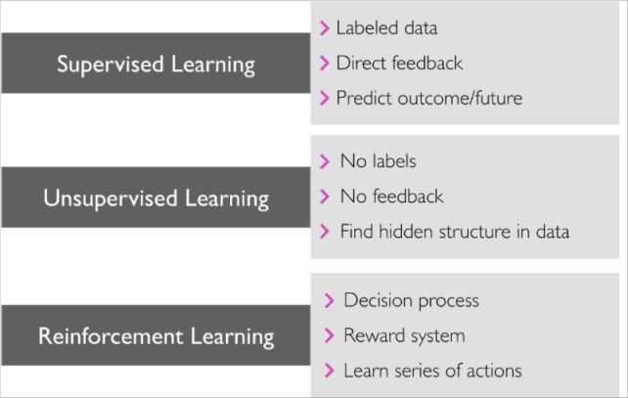
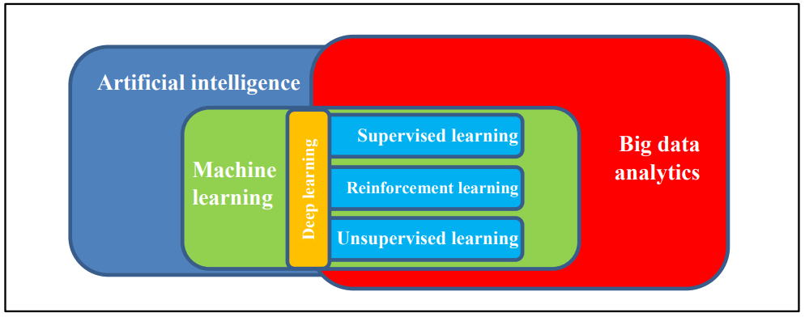
Types of machine learning
Supervised learning, where observations contain input/output pairs : These sample pairs are used to "train" the ML system to recognize certain rules for correlating inputs to outputs.
Unsupervised learning, where those labels are omitted: In this form of ML, rather than being "trained" with sample data, the machine learning system finds structures and patterns in the data.
Reinforcement learning, where evaluations are given about how good or bad a certain situation
Deep learning

Slide 30
supervised learning
In ‘supervised learning’, the algorithm is fed a set of ‘training’ data that contains labels on some portion of the observations.
For instance, a data set of transactions may contain labels on some data points identifying those that are fraudulent and those that are not fraudulent.
The algorithm will ‘learn’ a general rule of classification that it will use to predict the labels for the remaining observations in the data set.

Slide 31
Unsupervised learning
‘Unsupervised learning’ refers to situations where the data provided to the algorithm does not contain labels.
model uses unlabeled input data and allow algorithms to act on that information without guidance
exploratory data analysis - The algorithm is asked to detect patterns in the data by identifying clusters of observations that depend on similar underlying characteristics.
For example, an unsupervised machine learning algorithm could be set up to look for securities that have characteristics similar to an illiquid security that is hard to price.
If it finds an appropriate cluster for the illiquid security, pricing of other securities in the cluster can be used to help price the illiquid security.

Slide 32
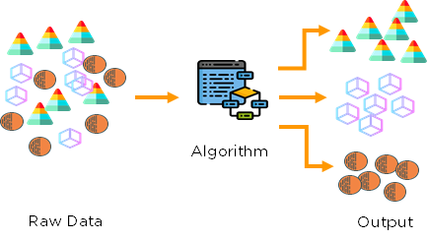
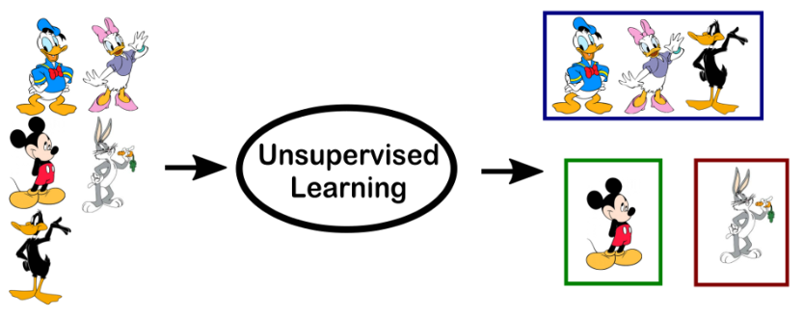
Unsupervised learning
Common tasks of unsupervised learning :-
Clustering
representation learning
density estimation
Aid in exploratory analysis
dimensionality reduction
Since no labels are provided, there is no specific way to compare model performance in most unsupervised learning methods.
EASY IN THEORY BUT HARD IN PRACTICE

Slide 33
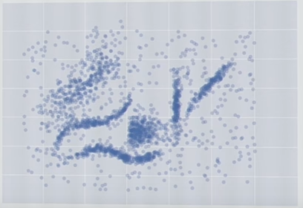
Human eye and clustering
Human eye can easily pick the clusters here depicted in 2D
Easy !!!

Slide 34
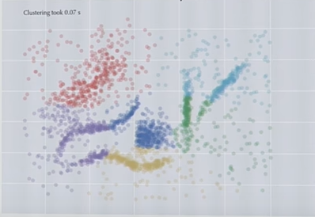
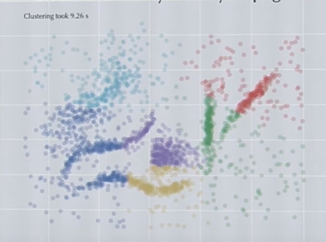
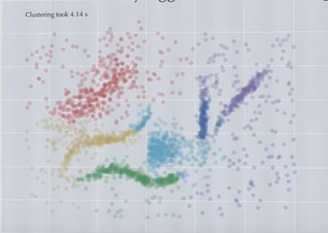
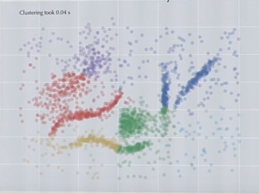
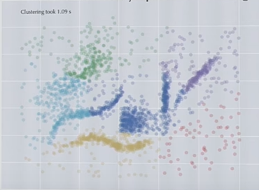
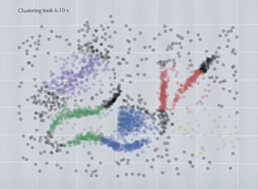
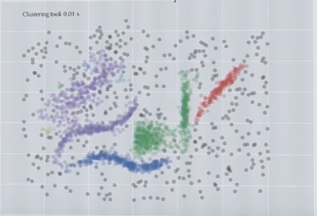
Results by various clustering techniques
Kmeans results
AffinityPropagation
Hierarchical agglomerative clustering
BIRCH (good for speed)
What makes it so hard?
SpectralClustering (uses kmeans)
Meanshift (uses kmeans)
DBSCAN (best of the lot)

Slide 35
What does clustering mean?
Useful method for EDA
Clusters need not be spherical/ ball (convex) shape
Not every point is in a cluster, REAL data has noise
Clusters are dense areas separated by less dense areas

Slide 36
Few tips on clustering
First step
K-means shouldn’t be the 1st choice for the clustering exercise
K-means shouldn’t be the 2nd choice for the clustering exercise, either !!!
Decide on what the goal of clustering is
If the goal is to perform EDA (understand data – shapes, distinct groups)
Start with DBSCAN or HDBSCAN

Slide 37
Reinforcement learning
‘Reinforcement learning’ falls in between supervised and unsupervised learning.
In this case, the algorithm is fed an unlabeled set of data,
chooses an action for each data point
and receives feedback (perhaps from a human) that helps the algorithm learn.
For instance, reinforcement learning can be used in robotics, game theory and self-driving cars.

Slide 38
Deep learning
‘Deep learning’ is a form of machine learning that uses algorithms that work in ‘layers’ inspired by the structure and function of the brain.
Deep learning algorithms, whose structure are called artificial neural networks, can be used for supervised, unsupervised, or reinforcement learning.
Recently, deep learning has led to remarkable results in diverse fields, such as image recognition and natural language processing (NLP).
Deep learning algorithms are capable of discovering generalizable concepts, such as encoding the concept of a ‘car’ from a series of images.
An investor might deploy an algorithm that recognizes cars to count the number of cars in a retail parking lot from a satellite image in order to infer a likely store sales figure for a particular period.

Slide 39
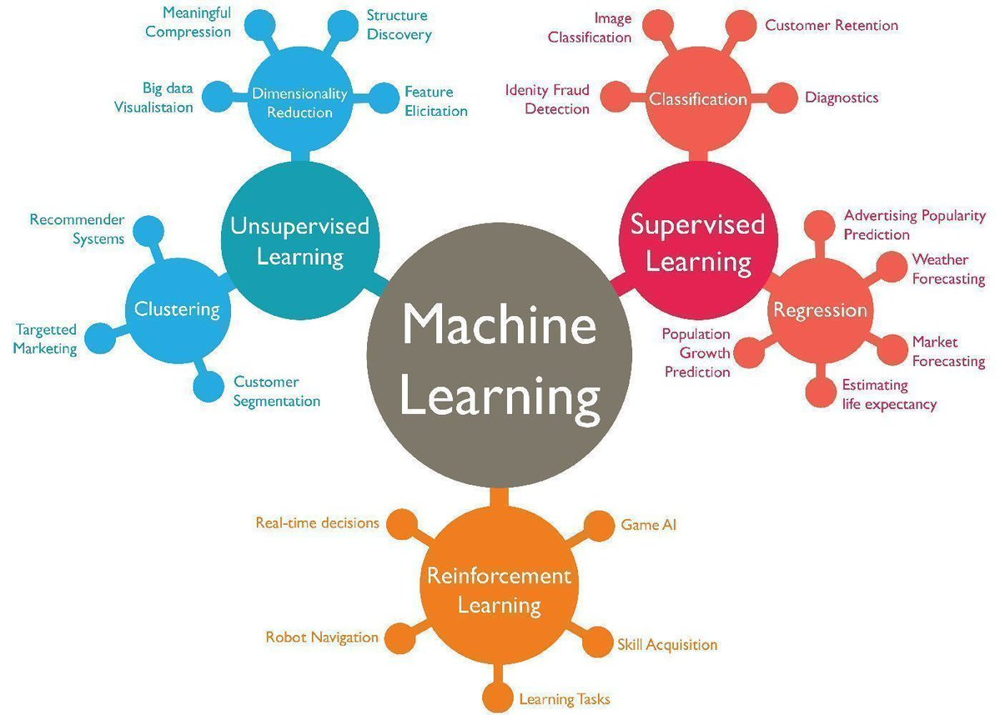
Machine learning types and use cases

Slide 40
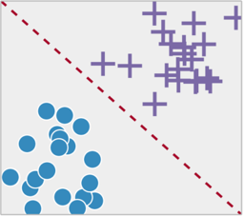
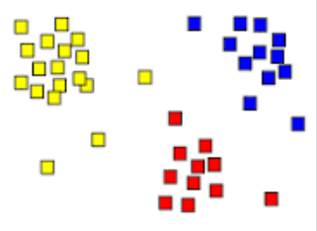
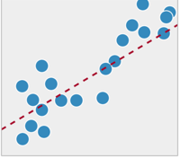
Learning methods
UN-SUPERVISED
KNN
Naïve-Bayes
Decision Trees
Random forests
Logistic Regression
Ordinal Logistic regression
multinomial logistics
Support Vector Machines (SVC)
ANN
Discriminant Analysis
Classification
K-Means
K-Medoids
Fuzzy C-Means
Hierarchical
Neural Networks
Hidden Markov Model
Clustering
SUPERVISED
Linear Regression
Polynomial
Decision trees
Random forests
Ordinal regression
Poisson regression
KNN
Support Vector Machines (SVR)
Regression
Dimensionality reduction (PCA)

Slide 41
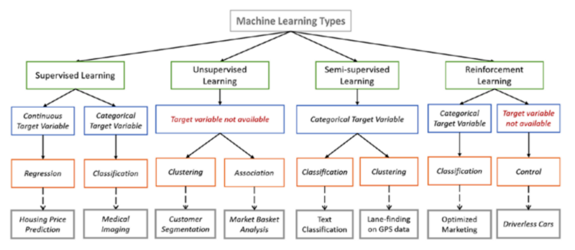
Machine learning

Slide 42
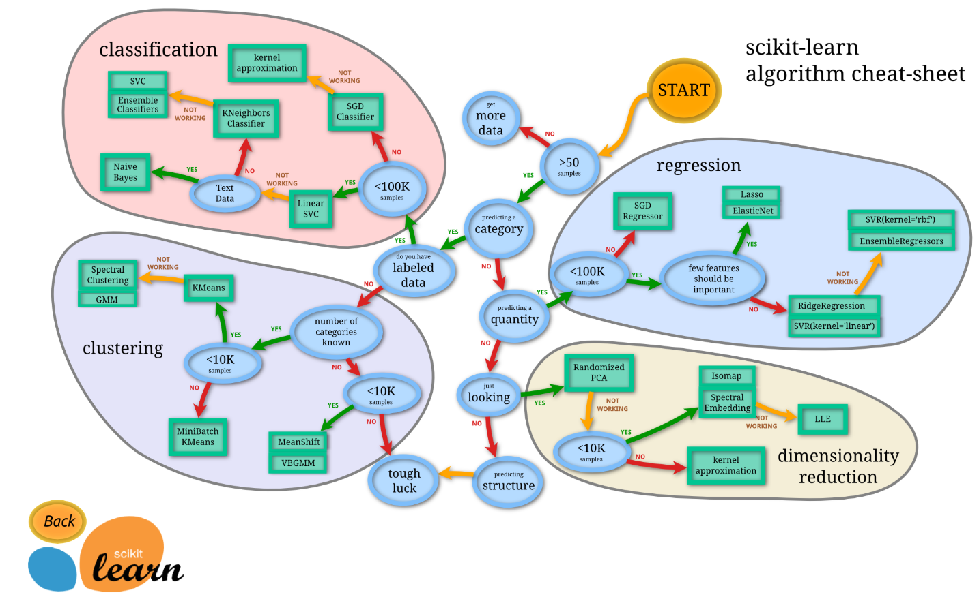
Machine learning – cheAt sheet

Slide 43
Strengths of ML
Speed, power, efficiency and intelligence
ML can deliver business insights more quickly and efficiently than traditional data analysis techniques
No need to program every possible scenario or require a human to be part of the process
More pervasive
Due to higher volumes of data collected
cloud data providers and vendors
Variety of data sources.
Increase/Augment the existing capability
Many organizations are replacing programs, such as Six Sigma, with ML algorithms

Slide 44
Challenges of ml
It requires considerable data and compute power.
Organizations will need to invest in infrastructure such as big data analytics cloud providers.
It requires knowledgeable data science specialists or teams.
Typically, organizations that are successful with ML have one or more data scientists on staff who are knowledgeable about ML
Complex data integration strategy.
Machine learning feeds off of large amounts of raw data, which often come from various sources. This brings a demand for advanced data integration tools and infrastructure, which must be addressed in a thorough data integration strategy.
Learning ML algorithms is challenging without an advanced math background

Slide 45
Challenges of ml
Context of data often changes.
For example, financial or demographic information used at the start of an ML analysis become less relevant before that analysis is complete, due to changes in external factors that have occurred in the meantime.
Also, when data is pulled from one context and integrated with data from another, this may have ramifications on its accuracy or validity.
Addressing these issues with advance data practices can be a challenge

Slide 46
Challenges of ml
Algorithmic bias,
privacy and ethical concerns may be overlooked.
It's easy to lose sight of privacy and ethical issues in our journey for exploration and discovery. If ML insights involve too much personal information, for example, this can raise moral or legal red flags.
A rising concern with ML includes determining if the predictions or outputs are discriminating based on data.

Slide 47
Parametric & non-parametric machine learning
Parametric | non-parametric
finite number of parameters | number of parameters is (potentially) infinite
a fixed structure or model | the complexity of the model grows with the number of training data
In the field of statistics, the term parametric is also associated with a specified probability distribution that you “assume” your data follows and this distribution comes with the finite number of parameters (for example, the mean and standard deviation of a normal distribution) | The method does not assume anything about the form of the mapping function other than patterns that are close are likely have a similar output variable
Nonparametric methods are good when you have a lot of data and no prior knowledge, and when you don’t want to worry too much about choosing just the right features. — Artificial Intelligence: A Modern Approach, page 757 | A learning model that summarizes data with a set of parameters of fixed size (independent of the number of training examples) is called a parametric model. No matter how much data you throw at a parametric model, it won’t change its mind about how many parameters it needs. — Artificial Intelligence: A Modern Approach, page 737

Slide 48
Parametric & non-parametric machine learning
In parametric modelling we use the training data to compute the parameters of the model, then at test time we use the parameters (i.e. not the training data) to make predictions on test points.
In non-parametric modelling we make predictions directly as a function of the training data, so we need to keep it during the test/validation time.
E.g. kmeans is parametric because you use the training data to choose where to place the k cluster, but then at test time you just need the cluster centers to make predictions. On the other hand, knn is non-parametric because we use the training data directly to make predictions at test time.
Bottom line:
If you need the training data to make predictions at test time then the model is non-parametric.
If you can throw the training data away after training then the model is parametric.

Slide 49
Parametric & non-parametric machine learning
Parametric | non-parametric
machine learning algorithms include: Naive Bayes Linear regression, Logistic Regression, RBF SVM Linear Discriminant Analysis Perceptron, Simple Neural Networks | machine learning algorithms are: k-Nearest Neighbors Decision Trees like CART and C4.5 Support Vector Machines (linear)
Benefits easier to understand and interpret results. very fast to learn from data. do not require as much training data | Benefits Capable of fitting a large number of functional forms. No assumptions about the underlying function. Can result in higher performance models for prediction.
Limitations highly constrained to the specified form. more suited to simpler problems. | Limitations Require a lot more training data to estimate A lot slower to train Overfitting: More of a risk to overfit the training data and it is harder to explain why specific predictions are made.

Slide 50
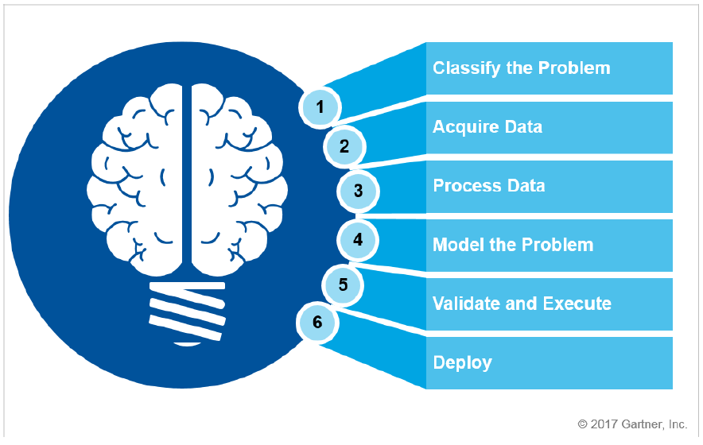
Stages of ml
The stages of ML often overlaps with the data science life cycle

Slide 51
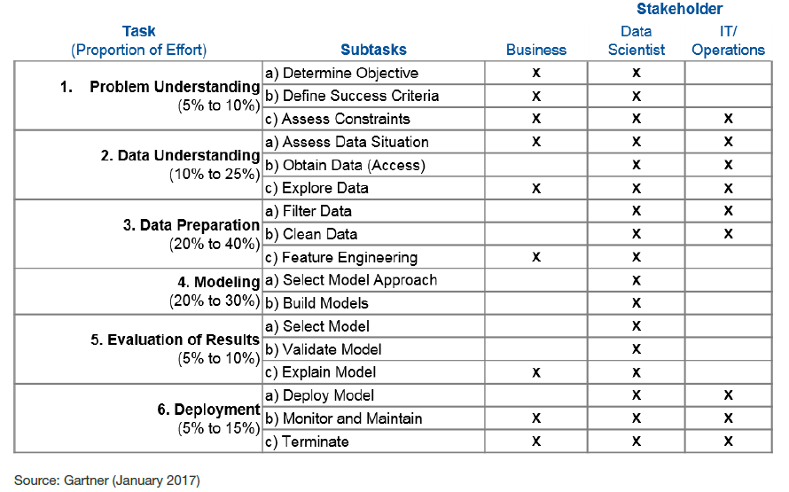
Data science life cycle
Building and operating an end-to-end machine learning system requires stakeholders made up of business subject matter experts, data scientists and IT operations

Slide 52
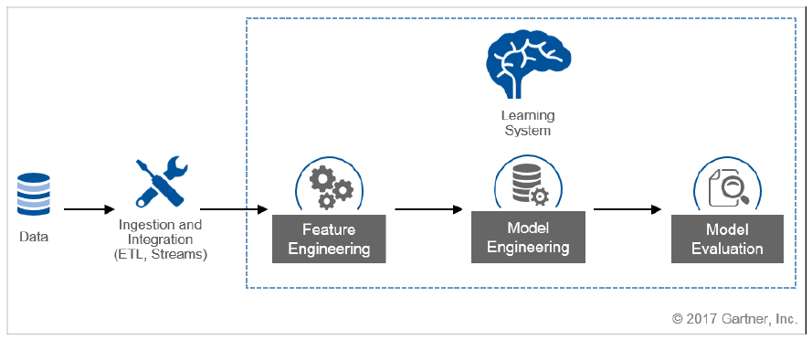
Life cycle -- summary

Slide 53
Stage - Data selection, preparation, and modeling
Data acquisition, where data is collected, prepared and forwarded for processing
Steps such as preprocessing, sample selection and the training of datasets take place
Feature engineering (a subset of the data processing component), where features that describe the structures inherent in the data are analyzed and selected

Slide 54
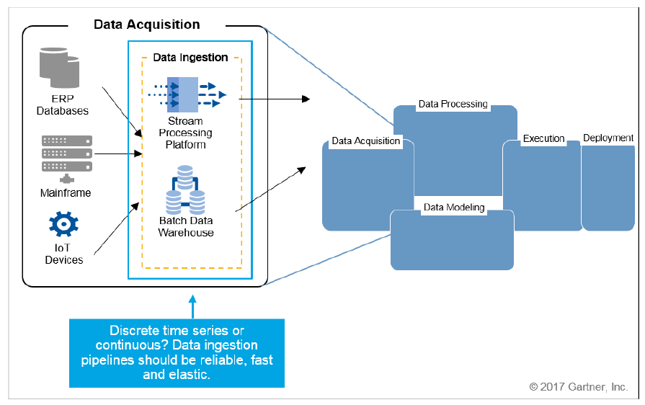
Data Acquisition
data is collected from a variety of sources and prepared for ingestion for ML data processing
ensure that the ingestion of ML data is reliable, fast and elastic.
Considerations for
Discrete – batch data
Streaming data - IOT

Slide 55
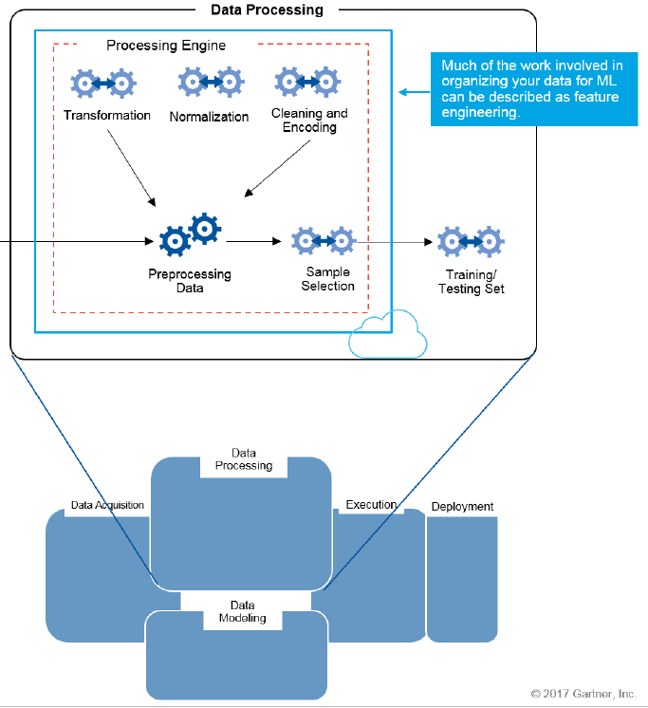
Data Processing/Integration
data munging or data wrangling –
Missing data – imputation (also called interpolation)
parsing
Scaling and/or normalization,
Encoding
dummy variables - convert qualitative variables to quantitative variables.
color feature (e.g., green, red, and blue), and transforming it to the values 1, 2, and 3 respectively
supervised learning - data splitting - prepare sets of data for training/ testing
Considerations
In-memory processing

Slide 56
Feature Engineering
Much of the data ingested for processing may include features (aka variables) that are redundant or irrelevant.
Select and analyze a subset of the data in order to reduce training time, or to simplify the model.
Feature selection is the process of selecting a subset of features
reduce the risk of overfitting, and thus improve model generalization
For regression problems
estimates of model parameters (i.e., model coefficients) and their significance,
correlation estimates amongst features.
Feature extraction
principle component analysis (PCA)
singular value decomposition (SVD)
Linear Discriminant Analysis (LDA)

Slide 57
PCA, SVD, LDA – in bits
Principal component analysis (PCA) is a statistical technique that deals with determining which features, in order, represent the most to least variance in the data.
Singular value decomposition (SVD) is a lower level linear algebra algorithm that is used by PCA.
Linear discriminant analysis (LDA) is closely related to PCA in that they’re both linear transformation techniques.
PCA however is more general and is not concerned with class labels (unsupervised),
Whereas LDA is more specific and is concerned with class labels (supervised).

Slide 58
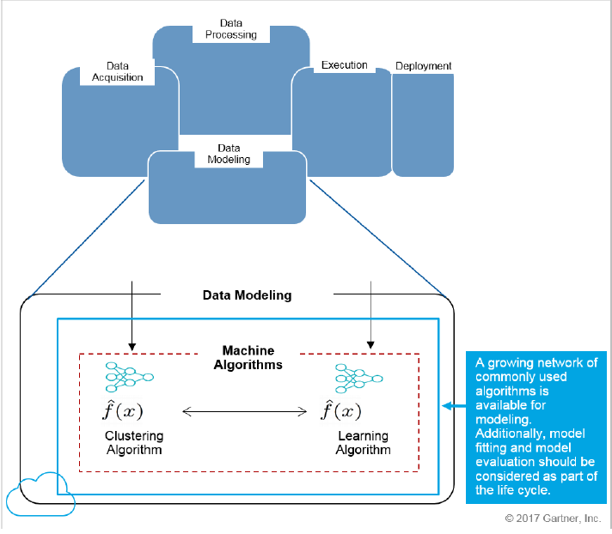
Model selection
The ML algorithm or model to be chosen may not matter as much as amount of data, feature selection
Considerations
Interpretability
Simplicity
Accuracy
Speed (training, testing, and real-time processing)
Scalability
start with simple models and then increase model complexity
KNN, NB, Linear Regression -> Decision trees, Random Forest, SVM
final model selection decision - leverage ensemble methods for additional performance gains.
combine models to produce a single consensus prediction and do so through averaging or voting techniques.

Slide 59
Model evaluation, validation, complexity and improvement
focus on problems associated with
overfitting / underfitting data
controlling model complexity,
model evaluation and errors introduction
model validation
tuning and improving model performance.

Slide 60

Overfitting
One of the greatest concerns in Data science project
Overfitting refers to a situation where the model chosen to fit the training data fits too well and essentially captures all of the noise, outliers and so on.
The consequence of this is that the model will fit the training data very well
will not accurately predict cases not represented by the training data
Will not generalize well to unseen data. lead to poor predictions on new data sets
Also known as “overtraining”
Data is fitted to a linear function and a polynomial function.
Linear function can be expected to generalize better: if the two functions were used to extrapolate beyond the fitted data,

Slide 61
Why overfitting happens
Overfitting occurs when a statistical model or machine learning algorithm captures the noise of the data.
Overfitting is often a result of an excessively complicated model
model has too many free parameters
E.g. for KNN, if K=1, training accuracy be close to 99%! Would this perform well for out of sample test observations? Hence this may lead to overfitting

Slide 62
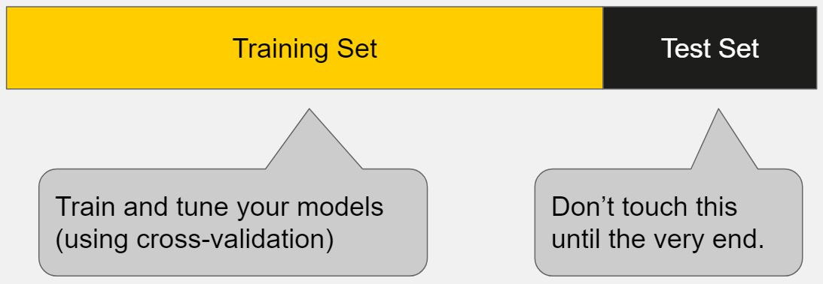
How to Detect Overfitting
A key challenge with overfitting, and with machine learning in general, is that we can’t know how well our model will perform on new data until we actually test it.
If our model does much better on the training set than on the test set, then we’re likely overfitting.
For example, if the model gives 99% accuracy on the training set but only 55% accuracy on the test set → case of overfitting

Slide 63
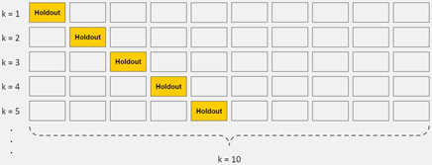
How to Prevent Overfitting
using validation or cross-validation methods
Train with more data | Training with more data may help algorithms detect the signal better
Remove features | Feature selection & Feature extraction
Smoothing techniques, Ensembling | Regularization, boosting and bagging

Slide 64
Underfitting
Underfitting occurs when an algorithm cannot capture the underlying trend of the data. Intuitively, it occurs when the model or the algorithm does not fit the data well enough.
Reasons for underfitting:-
excessively simple model.
when fitting a linear model to non-linear data
Underfitting would occur, for example, when fitting a linear model to non-linear data
Underfitting lead to poor predictions on new data sets.
Underfitting does not occur that often - Data sets that are used for predictive modelling nowadays often come with too many predictors,
Also known as “undertraining”

Slide 65
How to Prevent underfitting
Find more features (lower the bias)
Try high variance machine learning models (Decision Tree, k-NN, SVM

Slide 66
What it means is …
Maximizing the training accuracy, rewards the overly complex models that wont generalize
Goal should be to maximize the performance of the model on out-of-sample test observations

Slide 67
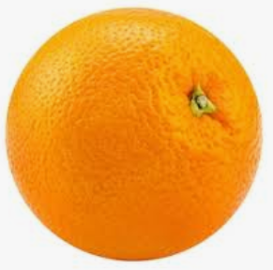
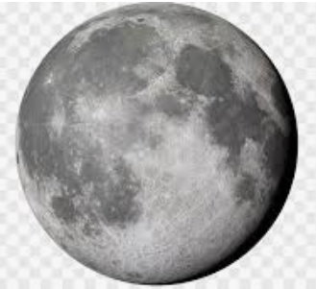
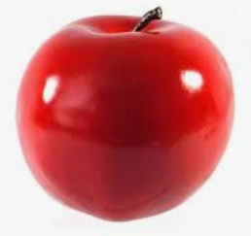
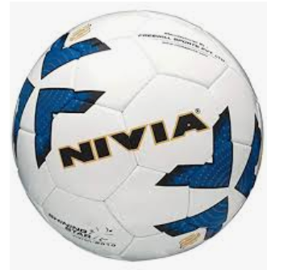



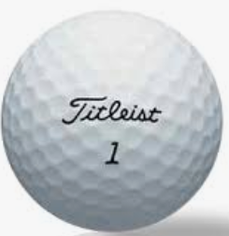
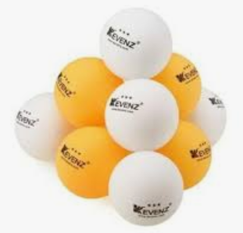
Let us understand
Scenario 1 : All shapes round | These are balls | Inference : All selected, biased towards ‘shape’, underfitting high bias, low variance
Scenario 2 : All shapes round Not eatable play with the ball | These are balls These are not balls | Inference : Right prediction
Scenario 3: All shapes round Not eatable play with the ball Ball has stich Greater than 70mm dia | These are balls | Inference : Overfitting Low bias, high variance
shapes
Detect a ball
These are not balls

Slide 68
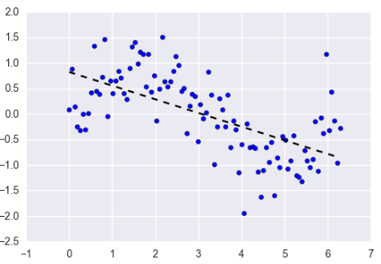
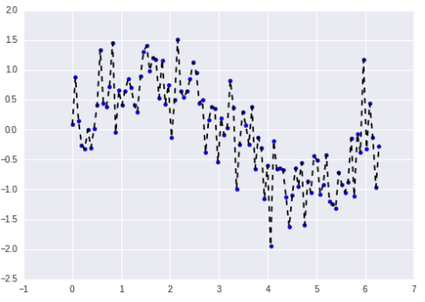
Bias and variance
Bias (underfitting)
Occurs when an algo has limited flexibility to learn
Bias is the difference between your model's expected predictions and the true values.
with high bias, regardless of how much training data you have the model will be a poor fit
Variance (overfitting)
Is how much the predictions for a given point vary between different realizations
high variance the training error will be very low,

Slide 69
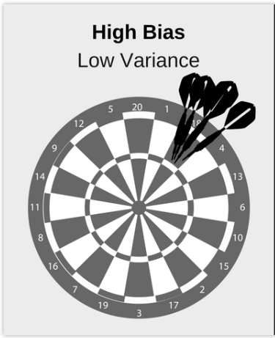
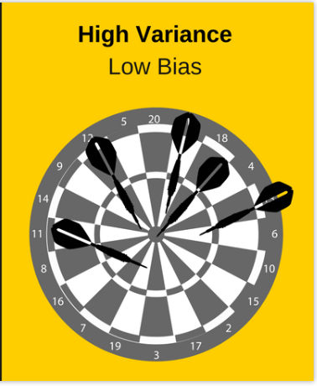
Bias-Variance Tradeoff
5 different training sets.
1 algorithm to train 5 models,
1 for each of the training sets.
Bias vs. variance refers to the accuracy vs. consistency of the models
Simple model
Inaccurate
Consistent
Complex model
accurate
Inconsistent

Slide 70

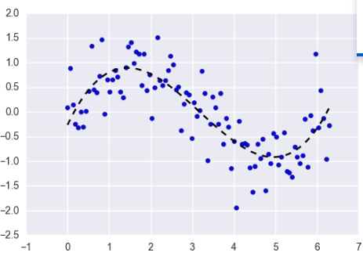
Bias, variance - balance
an optimal balance of bias and variance leads to a model that is neither overfit nor underfit:

Slide 71
Model Complexity
Model complexity can be characterized by many things and is a bit subjective.
Often refers to the number of features included in a given predictive model
whether the chosen model is linear, nonlinear and so on.
It can also refer to the algorithmic learning complexity or computational complexity.
Overly complex models are less easily interpreted, at greater risk of overfitting and will likely be more computationally expensive.

Slide 72
Measuring model complexity

Slide 73
Controlling model complexity
Methods by which to control model complexity
feature selection
subset selection (Forward and backward stepwise selection.)
shrinkage methods (including regularization)
ridge regression
Lasso
and dimensionality reduction.

Slide 74
Dimensionality reduction
Is a technique used to reduce the number of features
A technique that transforms the original predictors to a new, smaller set of predictors
help reduce complexity, reduce computational cost, and increase machine learning algorithm computational speed.
Principal component analysis (PCA) - a widely-used dimensionality reduction technique
.
Use of PCA to prevent overfitting since fewer features implies that the model is less likely to overfit.
it is not a good approach. Regularization should be used to address overfitting concerns instead.

Slide 75
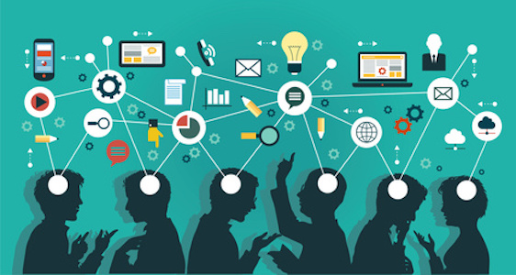
Model Evaluation and Performance
Model performance is typically used to describe how well a model is able to make predictions on unseen data (e.g., test, but NOT training data), and there are multiple methods and metrics used to assess and gauge model performance.
A key measure of model performance is to estimate the model’s test error.

Slide 76
improving Model Performance and Ensemble Learning
ways to improve a model’s performance.
The quality and quantity of data used has a huge, if not the biggest impact on model performance, but sometimes these two can’t easily be changed.
Other major influencers on model performance include
algorithm tuning
feature engineering
cross-validation
ensemble methods.

Slide 77

Model performance and error analysis
Regression performance | Classification performance
R² and adjusted R² (aka explained variance) Mean squared error (MSE), or root mean squared error (RMSE) Mean error, or mean absolute error Median error, or median absolute error | Confusion matrix Precision Recall (aka sensitivity) Specificity Accuracy Lift Area under the ROC curve (AUC) F-score Log-loss Average precision Precision/recall break-even point Mean cross entropy Probability calibration

Slide 78
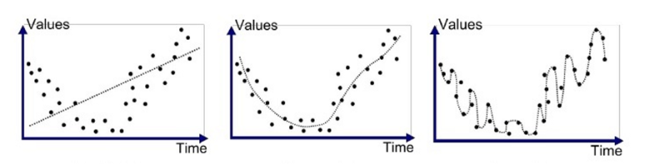
underfitting and overfitting
Underfitting
Good fit
Overfitted
Line does not cover all the points
Low variance
High bias
Line covers majority of the points
Optimum variance
Optimum bias
Line covers all the points
High variance
Low bias

Slide 79
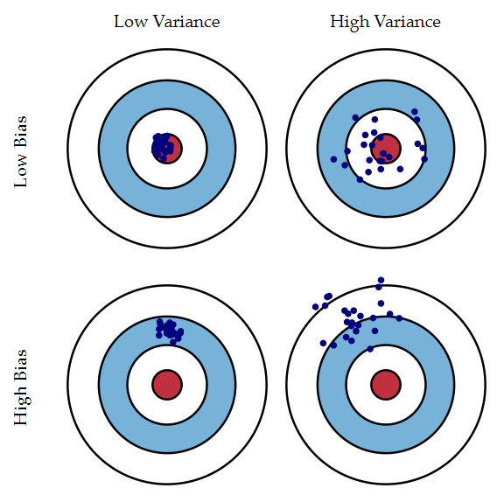
Bias - variance

Slide 80
bias and variance - Bias
How close is the predictive model is to the training data
Generally algorithm has high bias which help them to learn fast and easy to understand but are less flexible. That looses it ability to predict complex problem, so it fails to explain the algorithm bias.
This results in underfitting of our model.
Low Bias: Suggests less assumptions about the form of the target function.
Examples : Decision Trees, k-Nearest Neighbors and Support Vector Machines.
High-Bias: Suggests more assumptions about the form of the target function.
Examples : Linear Regression, Linear Discriminant Analysis and Logistic Regression.

Slide 81
bias and variance - Variance
Variance is the amount that the estimate of the target function will change if different training data was used.
Machine learning algorithms that have a high variance are strongly influenced by the specifics of the training data.
Low Variance: Suggests small changes to the estimate of the target function with changes to the training dataset.
Examples : Linear Regression, Linear Discriminant Analysis and Logistic Regression.
High Variance: Suggests large changes to the estimate of the target function with changes to the training dataset.
Examples : Decision Trees, k-Nearest Neighbors and Support Vector Machines.

Slide 82
Bias-Variance Trade-Off
Below are two examples of configuring the bias-variance trade-off for specific algorithms:
The k-nearest neighbors algorithm has low bias and high variance, but the trade-off can be changed by increasing the value of k which increases the number of neighbors that contribute to the prediction and in turn increases the bias of the model.
The support vector machine algorithm has low bias and high variance, but the trade-off can be changed by increasing the C parameter that influences the number of violations of the margin allowed in the training data which increases the bias but decreases the variance.
There is no escaping the relationship between bias and variance in machine learning.
Increasing the bias will decrease the variance.
Increasing the variance will decrease the bias.

Slide 83
Model persistence
let’s look at how Wikipedia defines a pickle
“Pickling is the process of preserving or expanding the lifespan of food by either anaerobic fermentation in brine or immersion in vinegar. The resulting food is called a pickle.”
Python pickling is the same process without brine or vinegar,
pickle your model for longer usage without the need for retrain the models.
In a “Pickling” process a Python object is converted into a byte stream.
In an “Unpickling” process a byte stream is converted back into Python object.

Slide 84
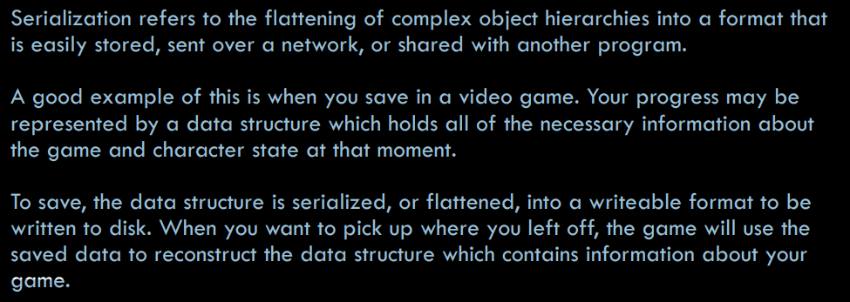
SERIALIZATION

Slide 85
methods
There are a number of application-dependent methods for serializing data in Python,
but the two most common (and probably the only ones you’ll need) are:
• pickle and cpickle
• json

Slide 86
pickle
the main mechanism provided by Python for serializing python objects.
turns a Python structure into a bytestream representation
Ease of sending across or storing
pickle can be used to reconstruct the original object.
can serialize:
• All of Python’s native datatypes: floating point numbers, Booleans, integers, etc.
• Lists, tuples, dictionaries, and sets containing any combination of native datatypes.
• Lists, tuples, dictionaries, and sets containing any combination of lists, tuples, dictionaries, and sets (and so on…).
• Functions, classes, and instances of classes.

Slide 87
CPICKLE
A faster pickle.
The cpickle module is the exact same algorithm implemented in C instead of Python.
Using cpickle means pickling at speeds up to 1000x faster than pickle.
However, you cannot create custom pickling and unpickling classes with cpickle.
But if customizability is not important for you, use cpickle.
The bytestreams produced by pickle and cpickle are identical so they can be used interchangeably on pickled data.

